Slide 1
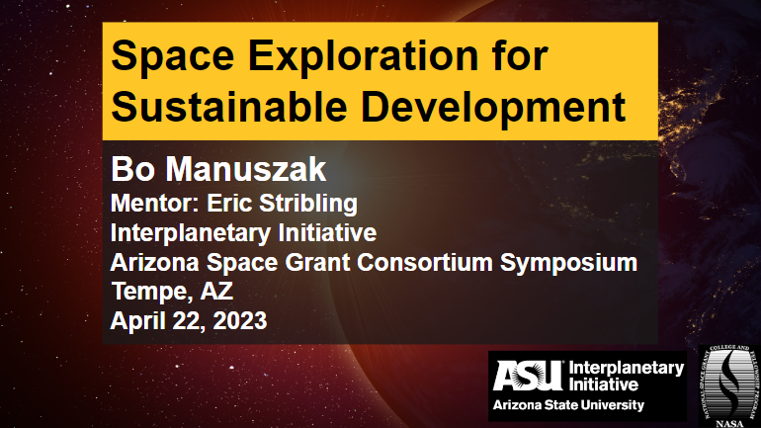

Slide 2

Phase I: Space Industry + SDGs

Slide 3
Our Question //
How does space exploration and development impact the UN Sustainable Development Goals (SDGs)?

Slide 4
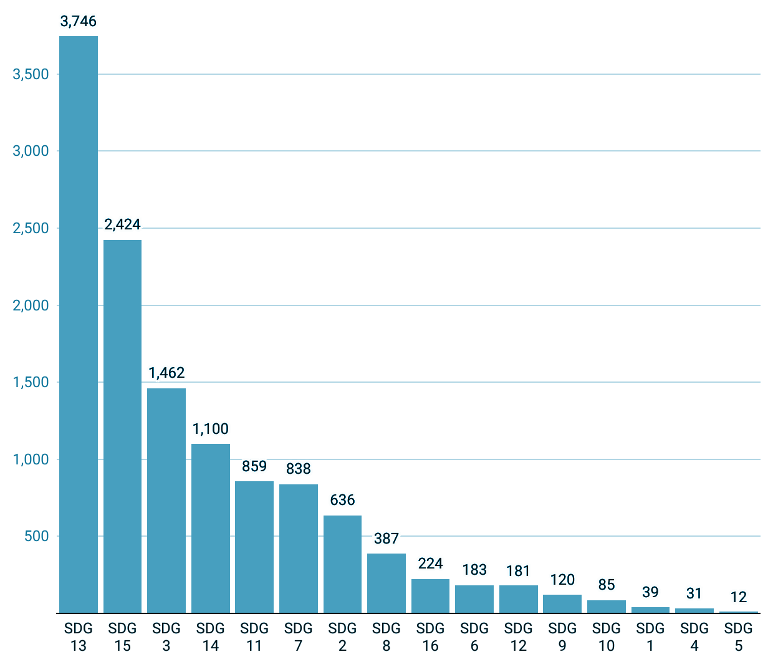





Methodology
Rapid Review Process
A type of systematic review designed for emerging topics and research
Used Scopus as our primary database with supplemental sources as necessary (NASA, etc.)
Utilized the Scopus predefined search queries for the SDGs combined with a space industry query generated by our research team
12,300+ items of academic literature reviewed from 2016 or later
Space Industry Query
SDG
Query

Slide 5
Results

Slide 6
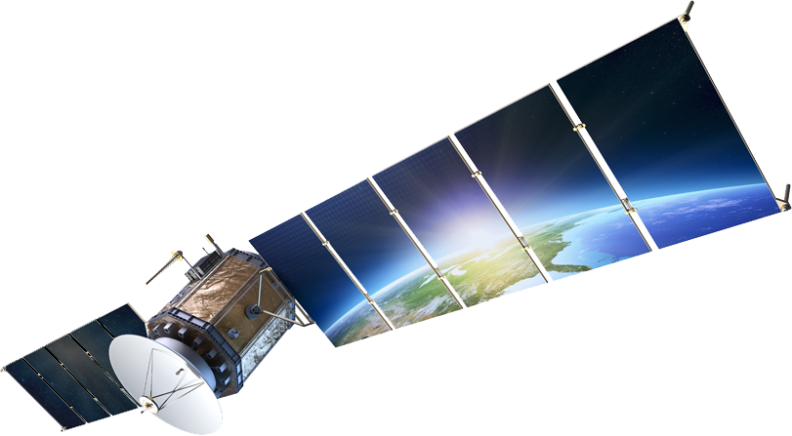
Results
4 spheres of impact from space industry
Satellite data, remote sensing and earth observations
Data acquisition and dissemination for informed decision making.
New manufacturing capabilities
Space exclusive gravitational, solar and material properties allow new avenues for manufacturing and material acquisition.
Spinoff technologies and technology transfers
Space technology that trickles down to use on Earth.
Social implications
Both positive and negative social implication from expansion towards space.

Slide 7
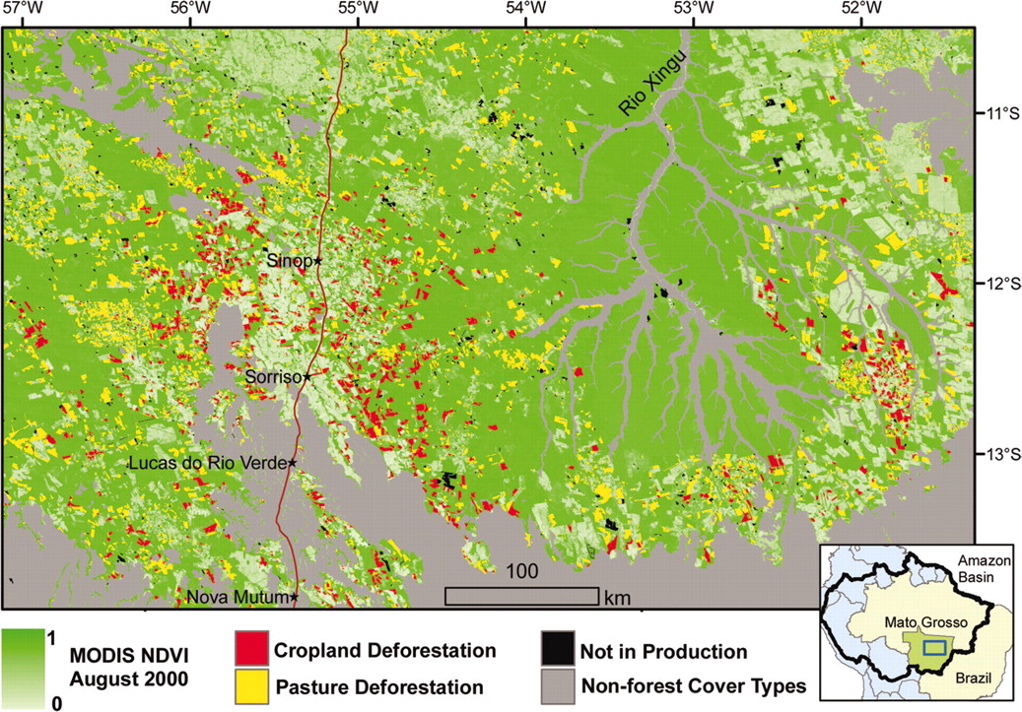
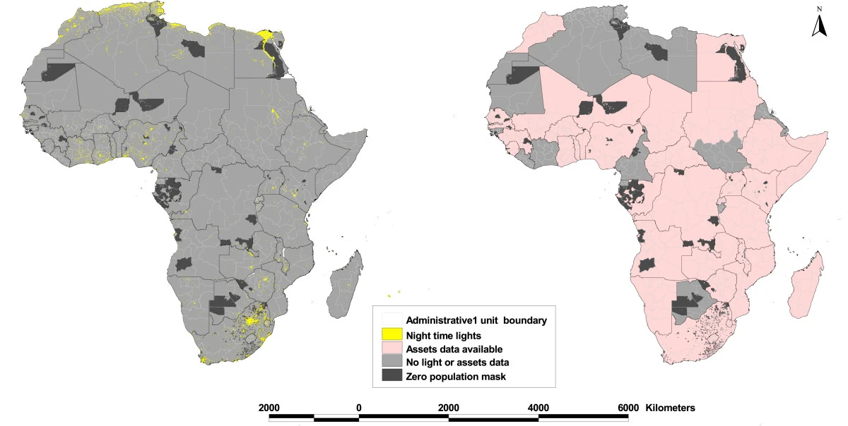
Satellite Data
Satellite data via earth observation and remote sensing are the main industries leading sustainability efforts
15 out of 17 SDGs were observed to have prominent satellite data applications
Including: monitoring of environmental, economic, human rights, and disaster trends
Notes:
BO
Briefly mention additional ones like human rights violations, climate change, etc. Left: Deforestation of the Amazon. (https://www.pnas.org/doi/10.1073/pnas.0606377103)
Right: NTL data being used as a proxy for poverty in Africa. (https://pophealthmetrics.biomedcentral.com/articles/10.1186/1478-7954-6-5)

Slide 8
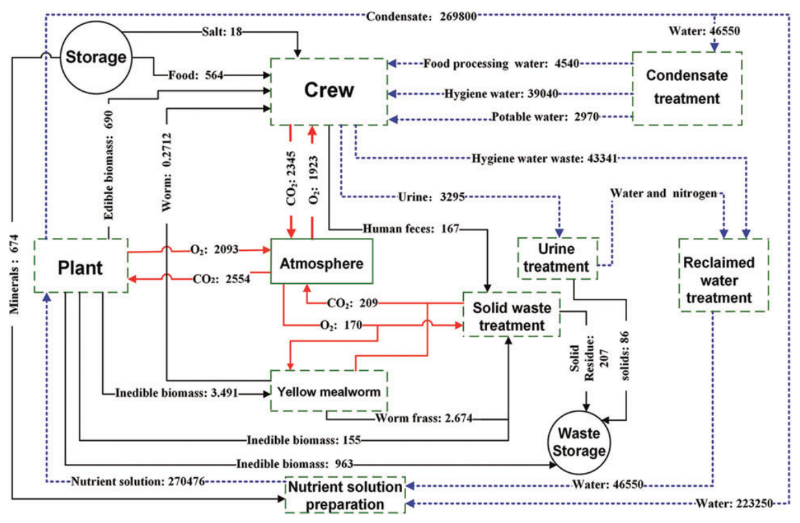
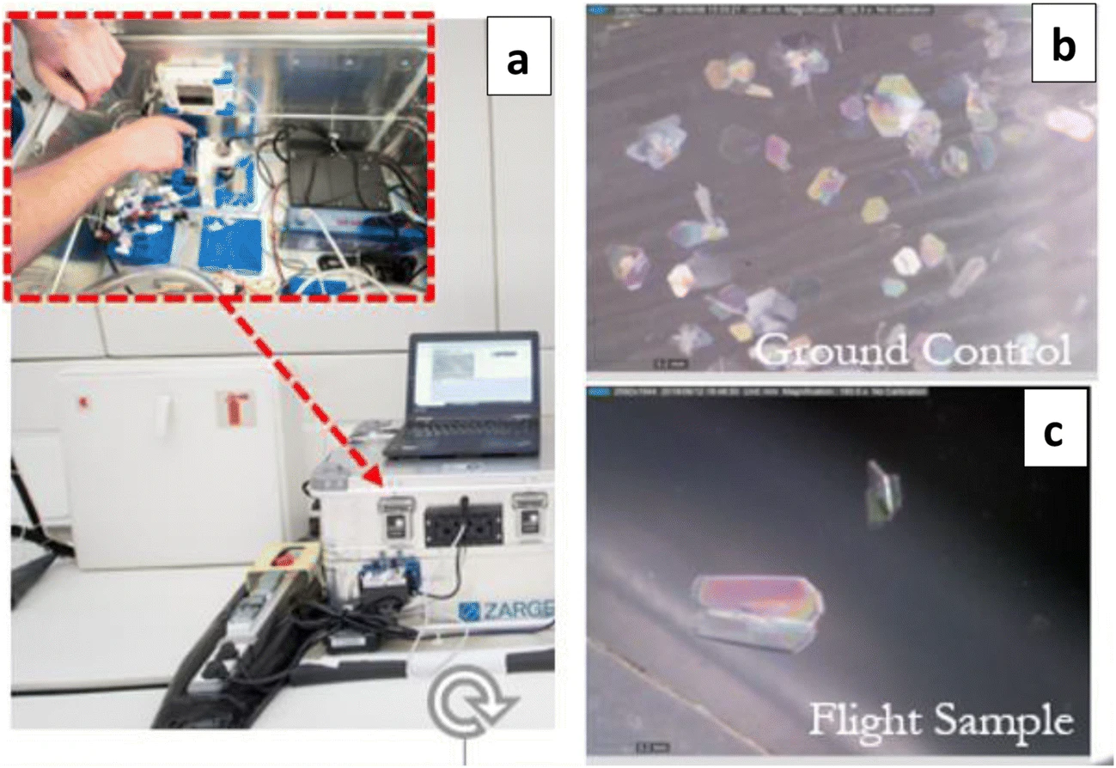
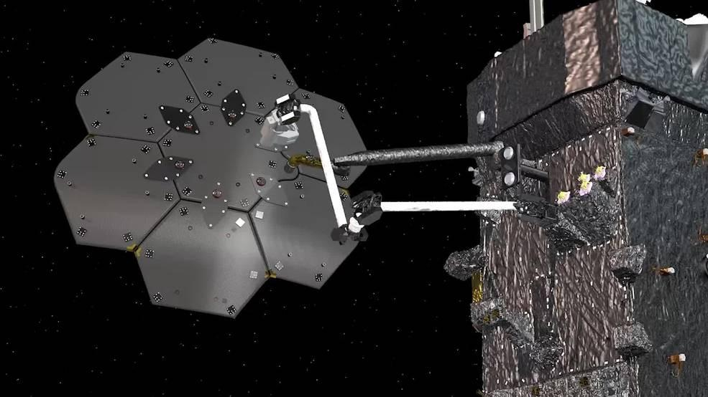
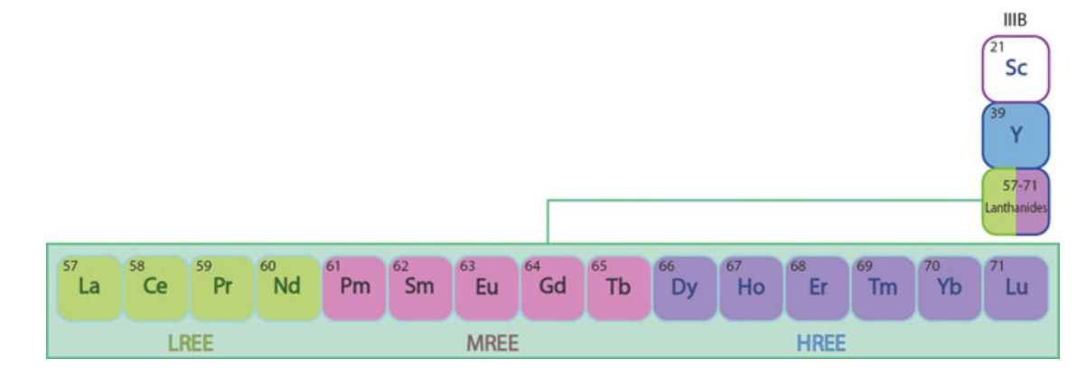
Innovation and Trickle Down Technology
SDG 2: Zero Hunger
Closed loop agriculture and alternative nutrition sources for harsh climates
SDG 3: Good Health and Wellbeing
Drug discovery, biosensors
SDG 7: Affordable and Clean Energy
Nuclear and solar energy, space based manufacturing
SDG 12: Responsible Production and Consumption
Asteroid mining and closed loop production as a result of sustainable space exploration and development
Notes:
SAR
1: Mass flow diagram from a sample bioregenerative life support system. (https://pubmed.ncbi.nlm.nih.gov/27912029/)
2:Peptide crystals prepared using SPmgLab under microgravity conditions during NoveSpace/Zero G parabolic flight mission. (https://link-springer-com.ezproxy1.lib.asu.edu/article/10.1007/s11095-019-2703-7)
3: A render of the Space Infrastructure Dexterous Robot (SPIDER) space manufacturing technology demonstration from NASA’s Restore-L spacecraft. (https://www.nasa.gov/press-release/nasa-funds-demonstration-of-assembly-and-manufacturing-in-space) 4: Rare earth elements that a study found much more abundant in asteroids and meteors. (https://link-springer-com.ezproxy1.lib.asu.edu/chapter/10.1007/978-3-319-46179-3_5#Fig5)

Slide 9
Social and Environmental Implications
SDG 5: Gender Equality
Gender disparities being increased and perpetuated more in space fields
SDG 10: Reduced Inequality
Unchecked development in space may have an impact on socioeconomic inequality
SDG 13: Climate Action
Unchecked space associated emissions may contribute to negative impacts on climate
Recognizing Bias
Literature is likely skewed towards benefits of the space industry for the SDGs and much of the literature was single studies and not common practice in the industry
Notes:
MALAIKA
Frivolous wealthy spaceflights is a display of obscene inequality
While airlines are by far attributed with more contribution to global emissions, space launches should not be neglected for consideration, especially with the expected increase of rocket emissions and remaining unknown impacts. https://everydayastronaut.com/rocket-pollution/https://everydayastronaut.com/rocket-pollution/

Slide 10
Phase II: Involving students in leveraging space technologies for achieving the UN SDG’s

Slide 11

SpaceHACK for Sustainability
SESD research takeaway:
EO is the main technology leading sustainability efforts
SpaceHACK for Sustainability seeks to involve students intaking advantage of ASU’s EO resources to find creative solutions for the SDG’s
The hackathon is student-centric but grounded in faculty research. We aim to birth research ideas for faculty and spur students on toward working hand-in-hand with faculty
I developed learning modules for Google Earth Engine targeted at STEM and non-STEM students alike

Slide 12

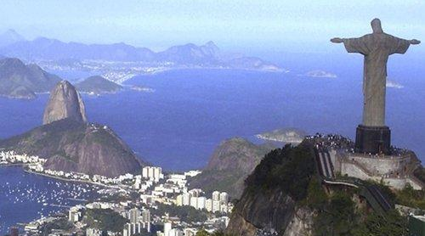
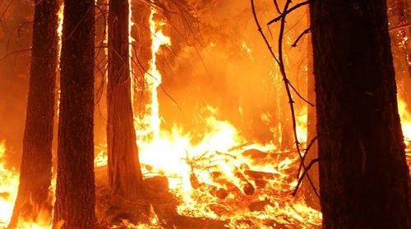
Global issues grounded in ASU research
Sustainable Water Access in Nepal
Climate Impacts on Brazilian Favelas
Wildfire Risk and Social Disparity
If groundwater levels can be accurately measured using satellite data, this would provide the opportunity for enacting public policy around the increasingly scarce resource of groundwater.
How might Climate Change be disproportionately impacting favelas in Brazil’s largest cities and how through remote sensing might we may be able to better alter and protect the region's most marginalized?
Can we better understand whether social inequities that often push poor and marginalized communities to certain areas are linked to greater wildfire risk of loss of life and property in regions of higher wildfire risk?

Slide 13
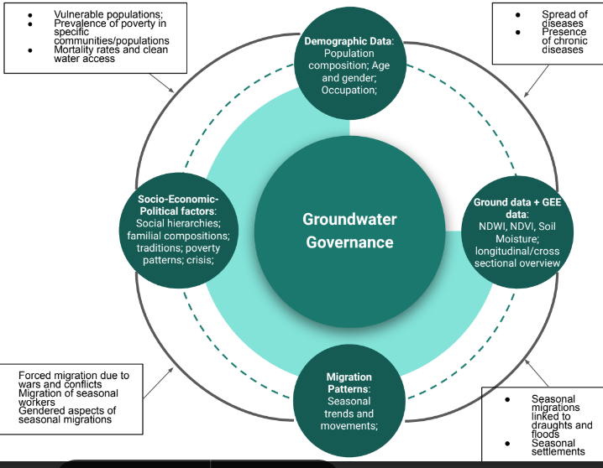
Sustainable Water in Nepal - 1st Place
This team first conducted a ground data analysis, where NDWI (plant water), NDVI (vegetation), and SMAP (soil moisture) satellite datasets were compared with measured groundwater levels and found a positive correlation between ground data and NDWI. The team then tested this hypothesis on two cases: Nawalparasi and Rautahat districts. These sites showed similar trends, suggesting the replicability of this algorithm. A governance model for groundwater was proposed that included NDWI but also socio-economic factors, migratory patterns, and demographics.
Below: This framework shows how satellite data can inform policy, but must be complemented by socio-economic-political context.
Prashamsa Thapa - Ph.D, Innov. in Global Development Giulia Genna - Ph.D, Innov. in Global Development Oceane Ingram - Sophomore, Electrical Engineering

Slide 14
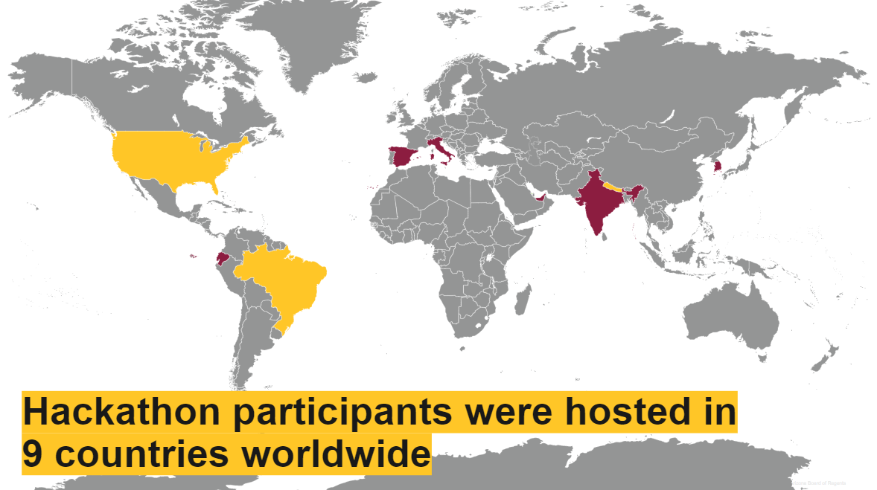

Slide 15

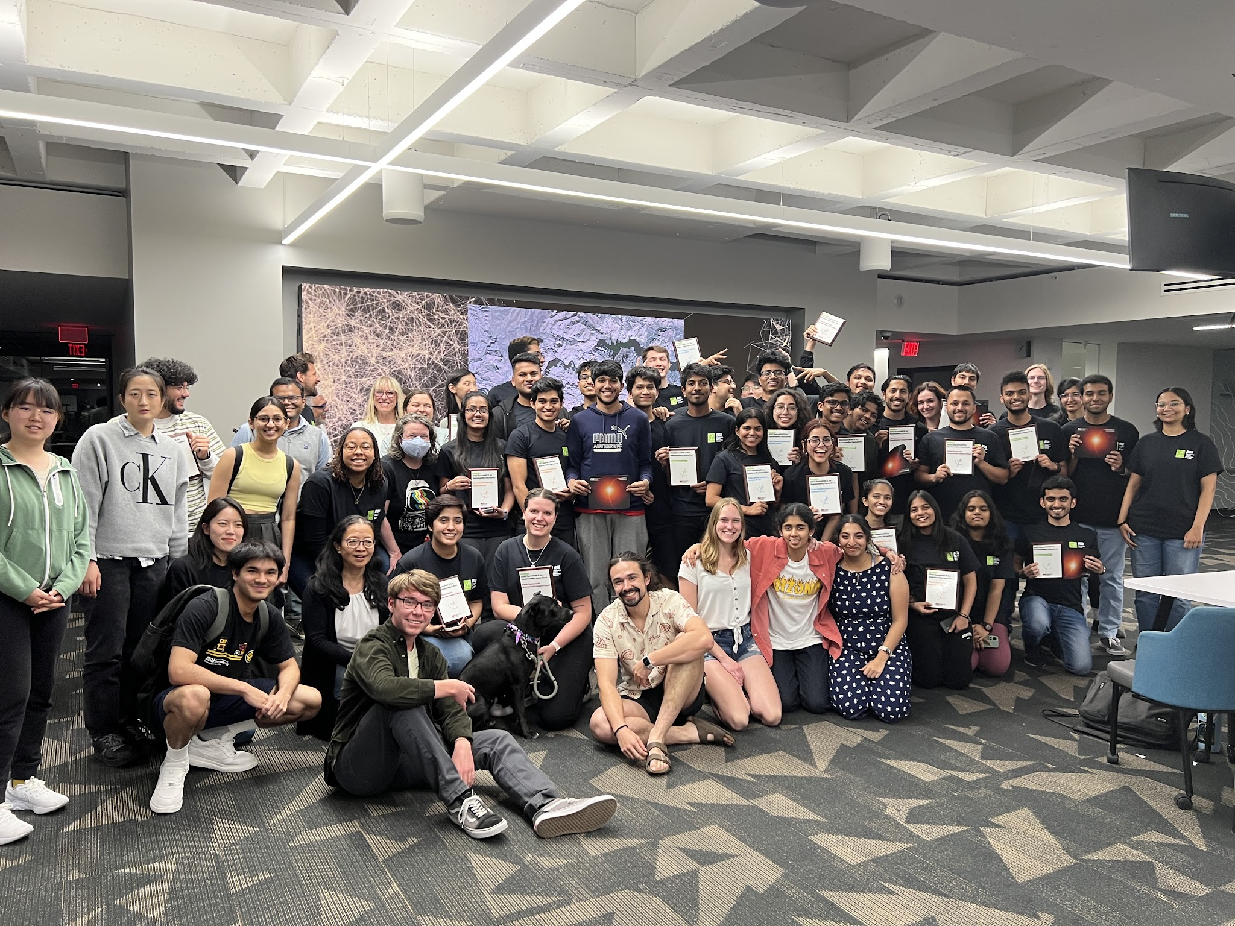
SpaceHACK 2023 by the numbers
138 Total students participated
Event highlights
2,800 total hours spent hacking
420+ hours of training provided by my curriculum
Digital immersion highlight
2 in 7 attendees participated online
71% Undergraduate participants
29% Graduate and PhD participants
35 academic majors represented by students
Students from 9 countries and 7 other universities participated, including:
Harvard, Yale, NAU, University of Nepal, and Universidad de Málaga (Ecuador).
82% Of participants represent STEM majors
18% Of participants represent non-STEM majors

Slide 16
Next Steps:
I have a passion for STEM education, so I will expand accessibility of the SpaceHACK for Sustainability by
Including Arizona high schools and community colleges in the hackathon
Teaching Google Earth Engine programming and satellite data interpretation/capabilities to these students
Increase engagement at international university partners in Ecuador and Nepal
Result: more exposure to using space sciences for sustainability for students around the world at all levels.

Slide 17
Acknowledgements
Mentor: Eric Stribling
Fellow researchers (for SESD): Madison Macias, Tasha Coelho, Malaika Malik, and Sarthak Bhardwaj
The Arizona State Space Grant Team for providing the opportunity to be involved in this meaningful research and enabling me to engage hundreds of students with space sciences for sustainability

Slide 18


Thank You!
Questions?
Contact bmanusza@asu.edu

